Slide 1
BookBok BookShop
Non-technical presentation

Slide 2
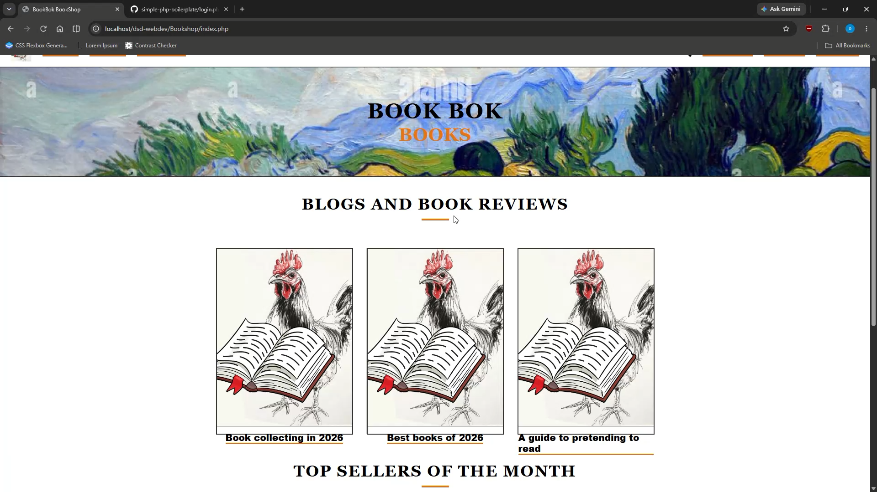
homepage

Slide 3
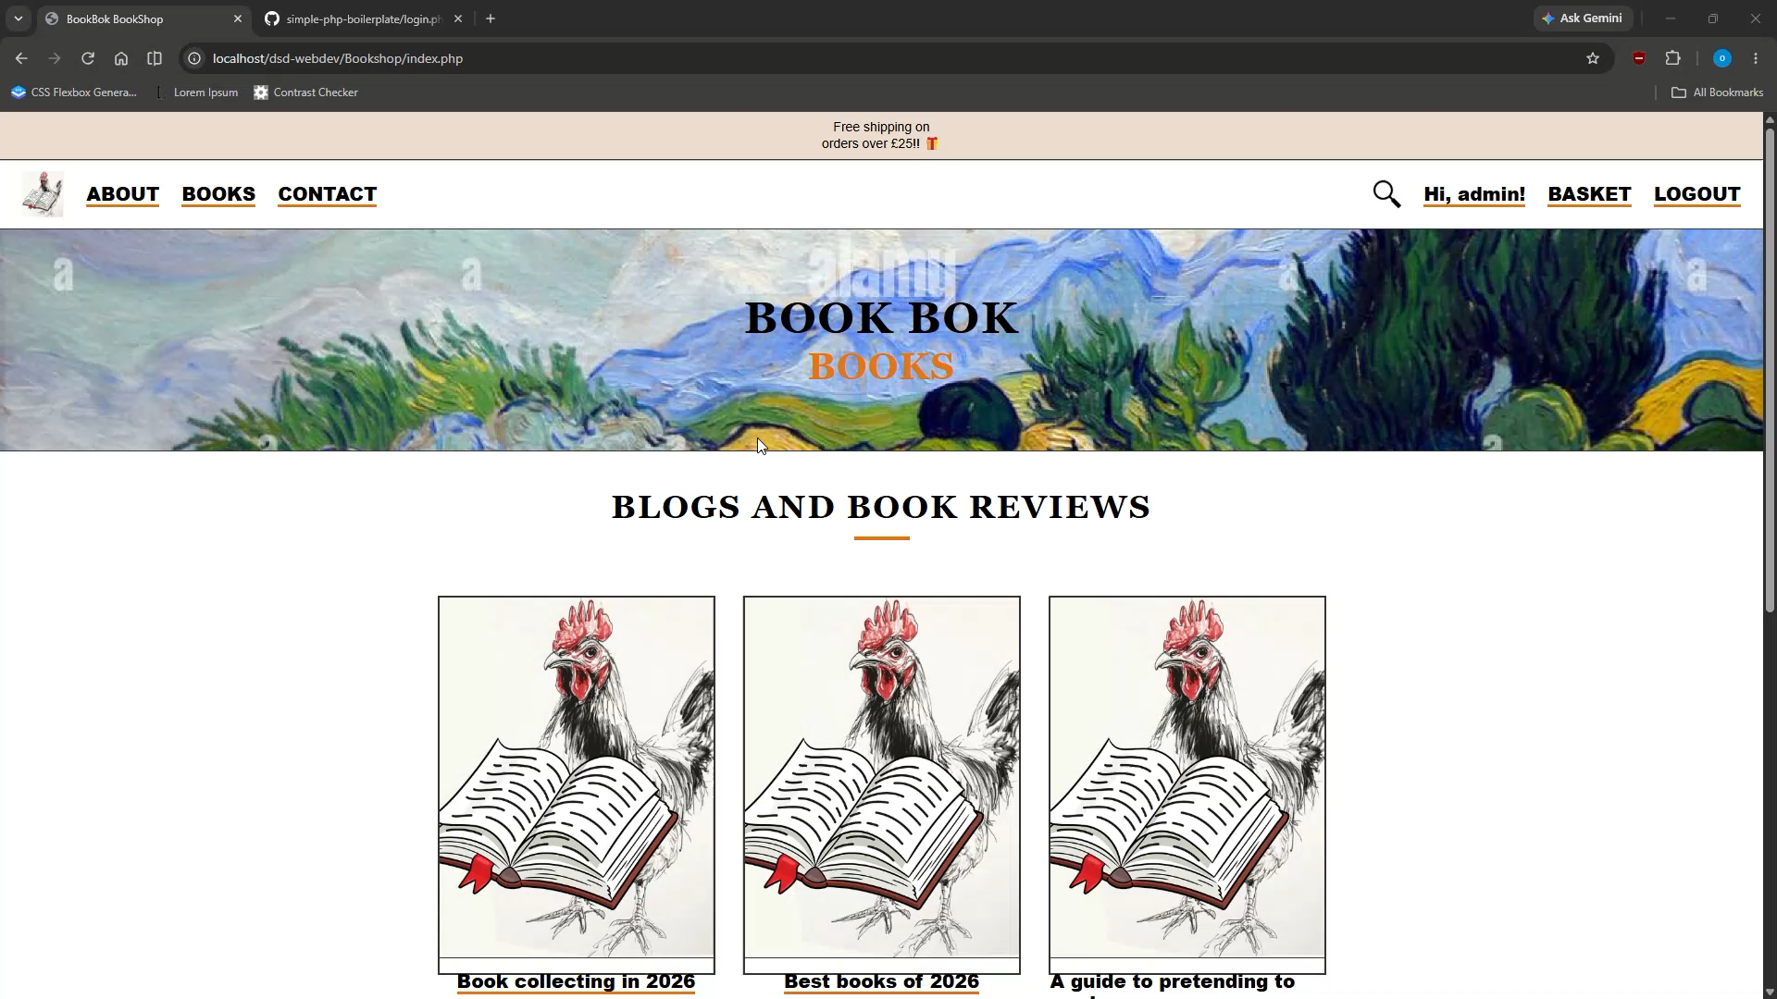
Navigation bar

Slide 4

login

Slide 5

logout

Slide 6

Sign up

Slide 7

Contact us

Slide 8

basket

Slide 9

Login/logout/sign up efficienty

Slide 10

about

Slide 11

Basket is not yet functional

